Slide 1
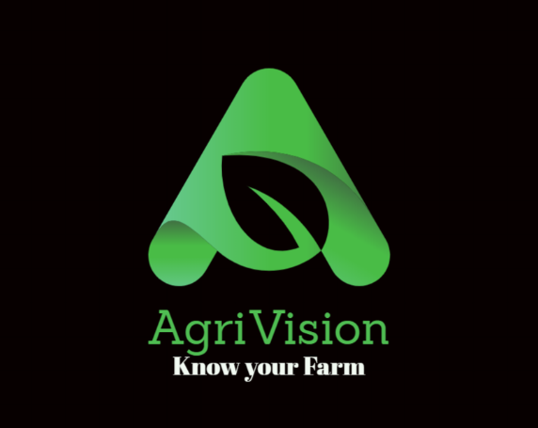
AgriVision
A complete solution to Crop Failure.

Slide 2
Timeline
Problem Statement
Existing Solution
Our Improvised Solution
Implementation
Technology
Future Scope

Slide 3
Problem Statement
CROP HEALTH MONITORING USING DRONES, ARTIFICIAL INTELLIGENCE AND IMAGE PROCESSING
How did we reach this statement?

Slide 4
The present scenario/the solution now being used
We have inferred from our research that the existing solutions to the issue of timely diagnosis of plant diseases are scarce in number. Those solutions which have the potential to be a game changer, are unfortunately designed in such a way that the average, illiterate farmer is unable to properly access it.

Slide 5
Our Solution
In order to increase yield, the area under cultivation is studied and suitable hybrid seeds are recommended.
The farmlands under observation are constantly monitored by a drone which alerts the farmers when an infected plant is detected.

Slide 6
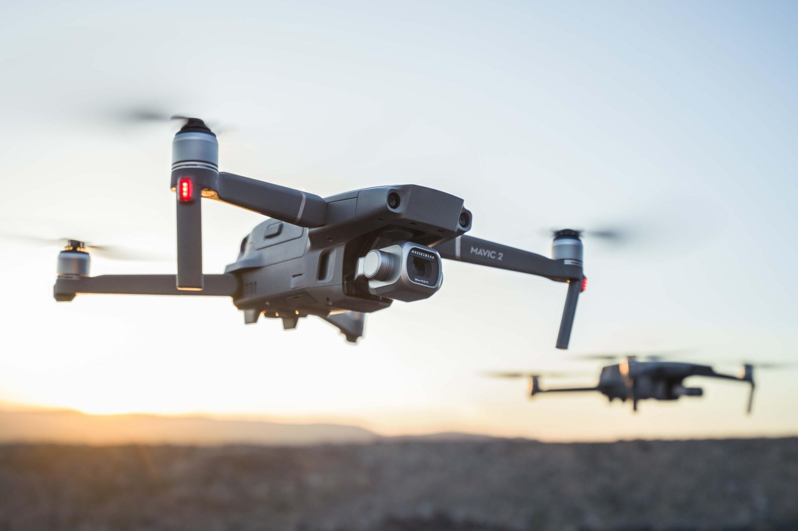
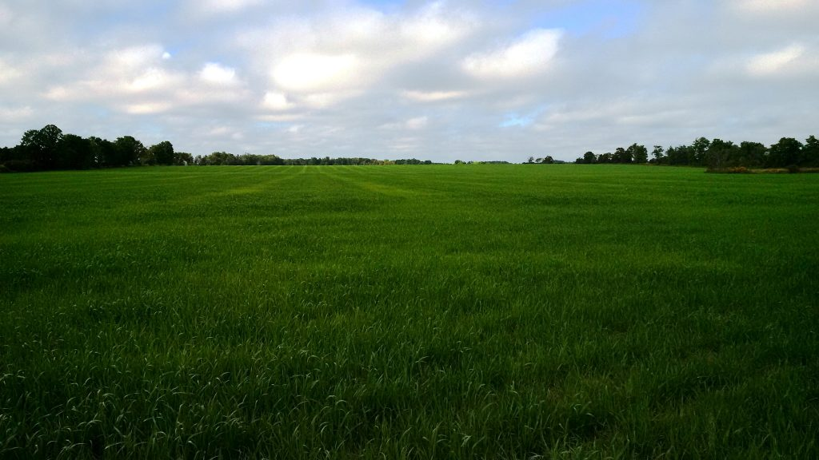
Implementation
There are 2 drones per sector. When one is operated, the other is charged.
24x7 alerting system
Two videos are recorded per day
The drone monitors farmland and sends information to respective agricultural offices.

Slide 7
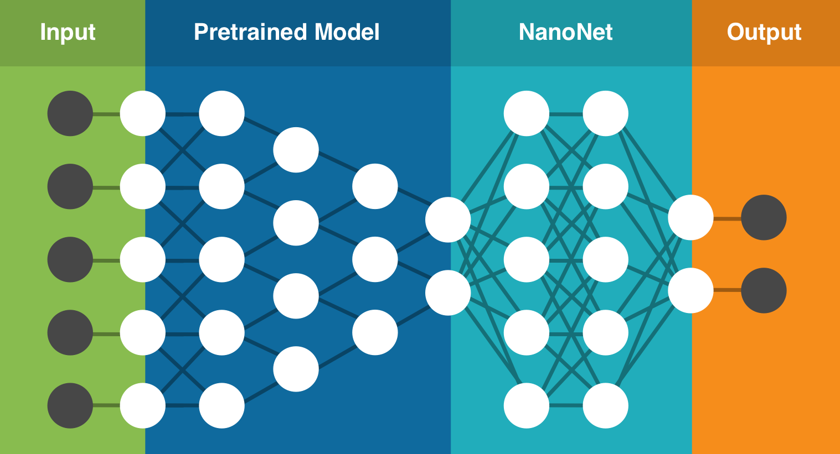
Technologies
Persona 01
Tensorflow (Transfer Learning)

Slide 8
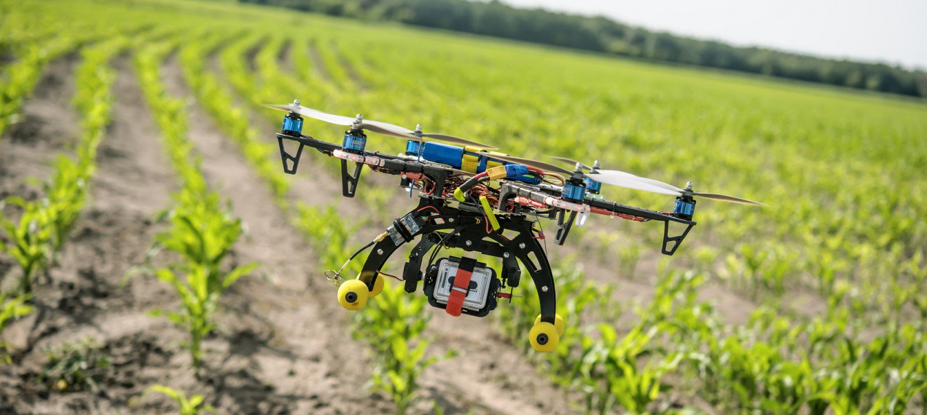
Demo

Slide 9
Future Scope
Potentially, this project can be scaled up on the following levels:
The software can be launched in a much larger scale, even at the national level, with cooperation from the government.
Other factors affecting financial conditions of farmers can be given attention to, thereby further expanding the project.

Slide 10
Thank you!

